Slide 1

GROUP 22
System Modelling and Design
Road Sign and Road State Notification Mobile App
Instructor: Dr Nkemeni Valery
TASK 4

Slide 2

CONTNENTS
01
Context Diagram
02
Dataflow Diagram
03
Use case Diagram
04
Sequence Diagram
05
Class Diagram
06
Deployment Diagram

Slide 3

GROUP 22
Introduction
This presentation outlines the system modelling phase of the Road Sign and Road State Notifications Mobile App, designed to improve driver safety through real-time alerts and road sign education.

Slide 4

YOUR LOGO
01
Context Diagram
The context diagram, focuses on the high-level interactions between a system and its external entities.

Slide 5

Context Diagram
This diagram effectively outlines the interactions and data exchanges among users, admins, and external services, illustrating the application’s functionality and scope.
Entities
System
Dataflows
User, System Admin, APIs
The central system
Movement of data
in the system.

Slide 6
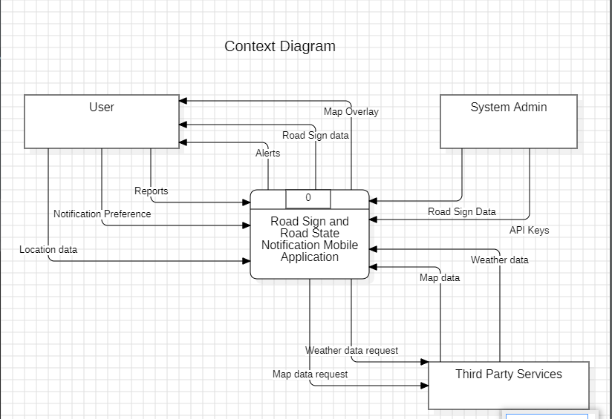

Slide 7

GROUP 22
02
Dataflow Diagram
Unlike the context diagram, the data flow diagram (DFD), delves deeper into the internal workings of the system.

Slide 8
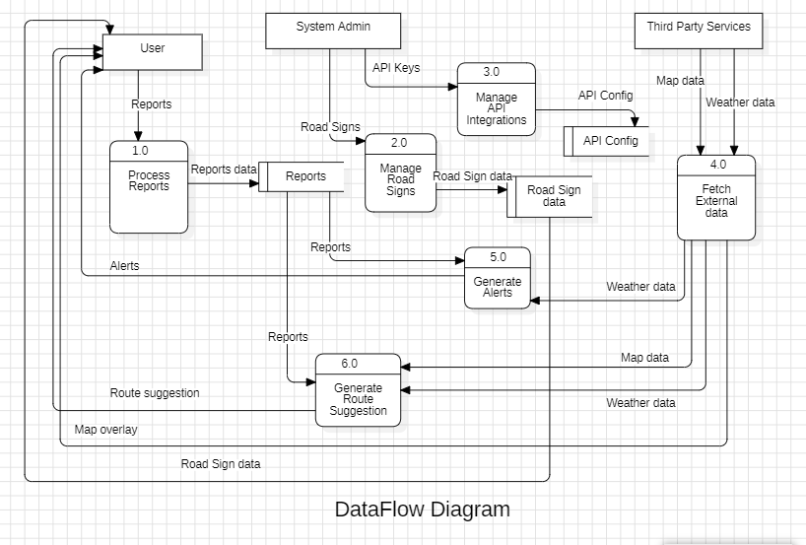
Dataflow Diagram
It illustrates how data moves within the system, showing processes, data stores, and the flow of information between different components

Slide 9

Dataflow Diagram
Entities
User, System Admin and Third Party Services, like APIs for weather and Traffic data
Processes
Manage Reports, Generate Alerts, Generate Route Suggestions, Manage Road Signs
Dataflows
User to Reports, Reports to User, Admin to API Keys, APIs to Road Signs

Slide 10
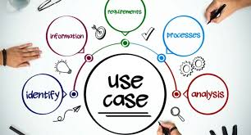
GROUP 22
03
Use case Diagram
Gives a visual representation of the interactions between users (or actors) and the Road Sign and Road State Notification App.

Slide 11

Use case Diagram
Recieve Alerts
Verify Reports
Road Users receive notifications about updates, such as road hazards or traffic changes
The transport authority reviews and verifies reports submitted by users to ensure accuracy
Manage Road Sign data
Provide Map
Admins have the ability to add, update, or remove road sign data ensuring data accuracy
The API supplies essential map data, enabling features like viewing and route selection

Slide 12
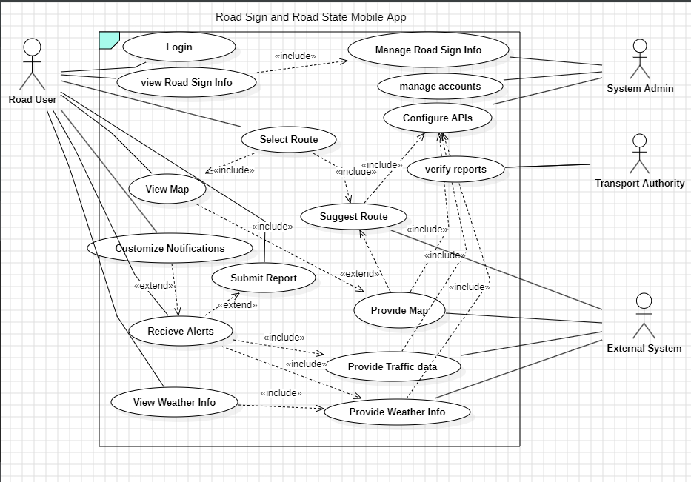
Use case Diagram

Slide 13
GROUP 22
04
Sequence Diagram
This illustrates how objects interact in a particular scenario of a use case, focusing on the order of messages exchanged.

Slide 14

Sequence Diagram
User Login
This sequence diagram illustrates the login process for a user within a mobile application, detailing the interactions between the user, the mobile app, and the system.
user reports
This sequence diagram illustrates the reporting process for a user within a mobile application, detailing the interactions between the user, the mobile app, and the system.
Alerts
This sequence diagram outlines the process of alerts within the mobile application, detailing the interactions between various components involved in the alert system.

Slide 15
GROUP 22
05
Class Diagram
The class diagram represents the classes, attributes, operations (or methods), and the relationships among objects in a system

Slide 16
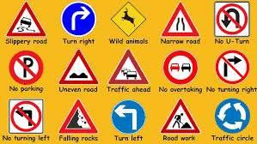

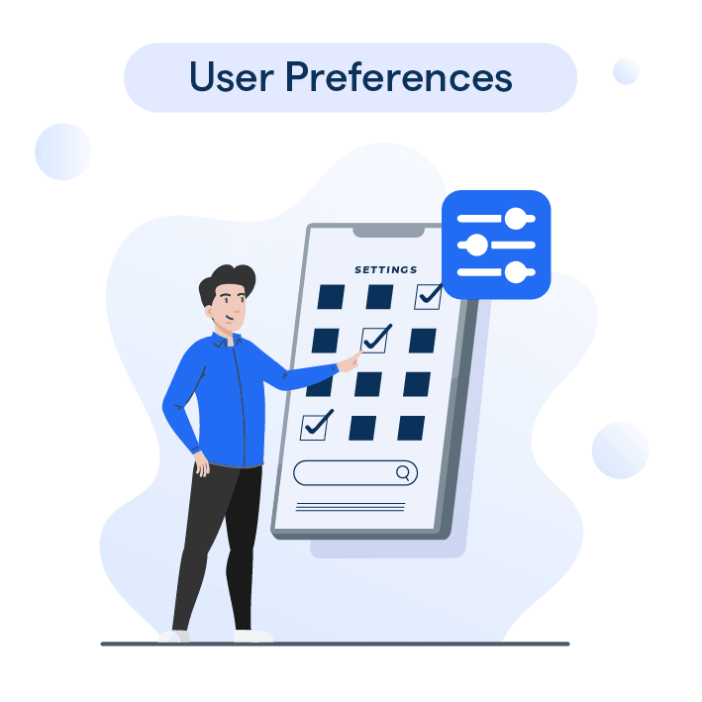
Class Diagram
RoadSign
RoadUser
UserPreference
Has attributes such as it’s ID, category, description and locations.
Has attributes such as it’s ID, name, Email, location and LastLogin
Has attributes such as it’s Notifications Enabled, voice or text, language preference.

Slide 17
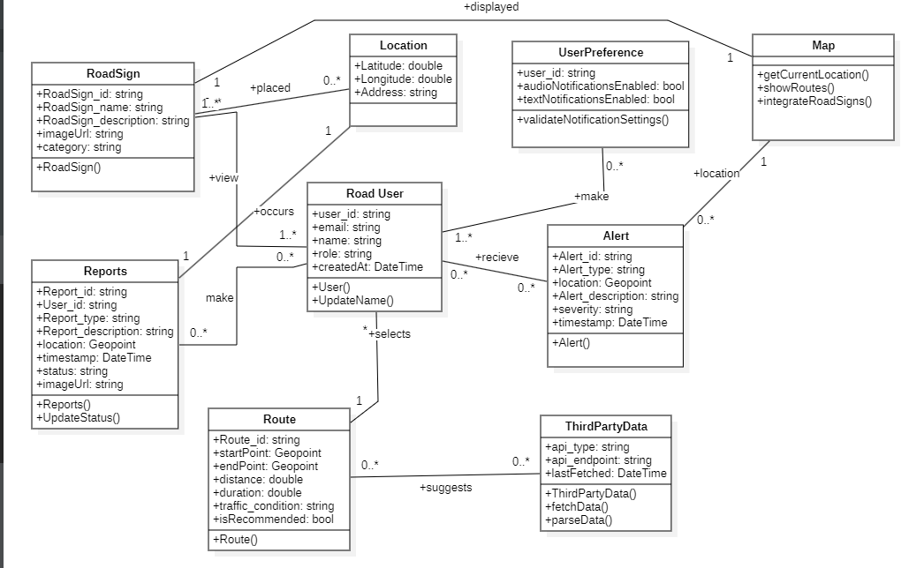

Slide 18

GROUP 22
06
Deployment Diagram
The deployment diagram illustrates the physical deployment of artifacts on nodes. It shows how software components are distributed across hardware and how they interact with each other and external systems.

Slide 19
Deployment Diagram
This deployment diagram represents the architecture of the Road Sign and Road State Notification Mobile Application, highlighting the components and their interactions. Here are the key components
Mobile Device
Firebase Cloud
APIs
The platform used by drivers to receive alerts and report road issues.
External services that provide additional data
The backend service that handles various functionalities

Slide 20
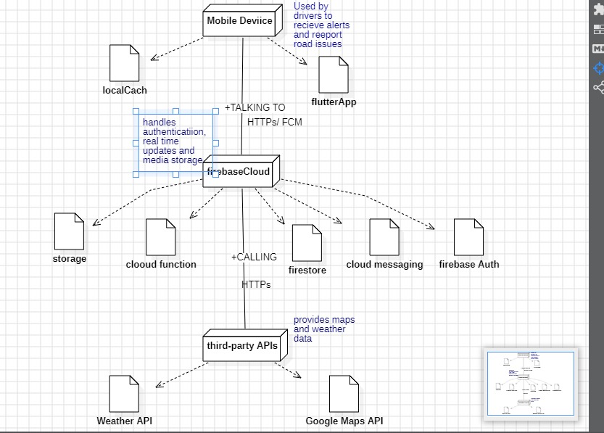
Deployment Diagram

Slide 21
GROUP 22
THANK YOU
FOR YOUR KEEN ATTENTION

